Slide 1


Huazhong University of Science and Technology
The Department of Electronics and Information Engineering
Electronic Circuit Analysis and Design
Dr. Tianping Deng
Email: dengtp@hust.edu.cn

Slide 2
Contents
PART 1 SEMICONDUCTOR DEVICES AND BASIC APPLICATIONS
Chapter 1 Semiconductor Materials and Diodes
Chapter 2 Diode Circuits
Chapter 3 The Field-Effect Transistor
Chapter 4 Basic FET Amplifiers
Chapter 5 The Bipolar Junction Transistor
Chapter 6 Basic BJT Amplifiers
Chapter 7 Frequency Response
Chapter 8 Output Stages and Power Amplifiers
PART 2 ANALOG ELECTRONICS
Chapter 9 Ideal Operational Amplifiers and Op-Amp Circuits
Chapter 10 Integrated Circuit Biasing and Active Loads
Chapter 11 Differential and Multistage Amplifiers
Chapter 12 Feedback and Stability
Chapter 13 Operational Amplifier Circuits
Chapter 14 Nonideal Effects in Operational Amplifier Circuits
Chapter 15 Applications and Design of Integrated Circuits
Chapter 12 Feedback and Stability

Slide 3
Ch12 Feedback and Stability
12.0 Preview
12.1 Introduction to Feedback
12.2 Basic Feedback Concepts
12.3 Ideal Feedback Topologies
12.4 voltage (Series-Shunt) Amplifiers
12.5 Current (Shunt-Series) Amplifiers
12.6 Transconductance (Series-Series) Amplifiers
12.7 Transresistance (Shunt-Shunt) Amplifiers
12.8 Loop Gain
12.9 Stability of the Feedback Circuit
12.10 Frequency Compensation
12.11 Summary

Slide 4
12.3.1 Series-Shunt configuration
12.3.2 Shunt-Series Configuration
12.3.3 Series-Series Configuration
12.3.4 Shunt-Shunt Configuration
12.3.5 Summary of Results

Slide 5
1. Types of Connection
Input: Two types of connection for input and feedback signals on input: series and shunt.
Output: Two types of connections for output and feedback signals on output: series and shunt.
Four connections are referred to as:
Series-shunt (voltage-sensing/voltage-comparing)
Shunt-series (current-sensing/current-comparing)
Shunt-shunt (voltage-sensing/current-comparing)
Series-series (current-sensing/voltage-comparing)

Slide 6
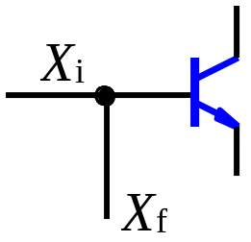
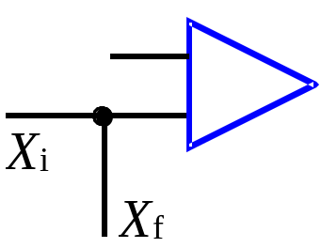
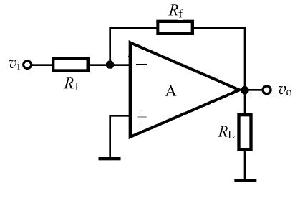
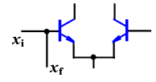

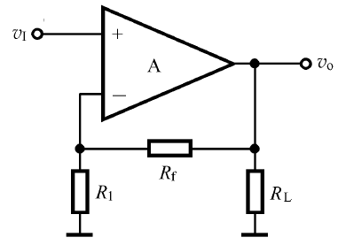
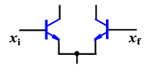
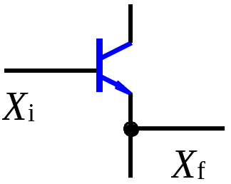
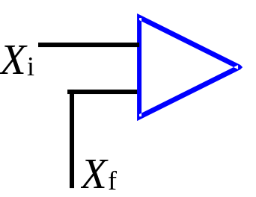
2. Recognizing Techniques
For input connection:
Shunt: feedback X_{f} and input X_{i}
connect to same terminal.
Shunt
Series: feedback X_{f} and input X_{i}
connect to different terminals.
Series

Slide 7
2. Recognizing Techniques
For output connection:
Series (current-sensing): When load is set short, feedback signal exists too.
Shunt (voltage-sensing): When load is set short, feedback signal is zero.

Slide 8
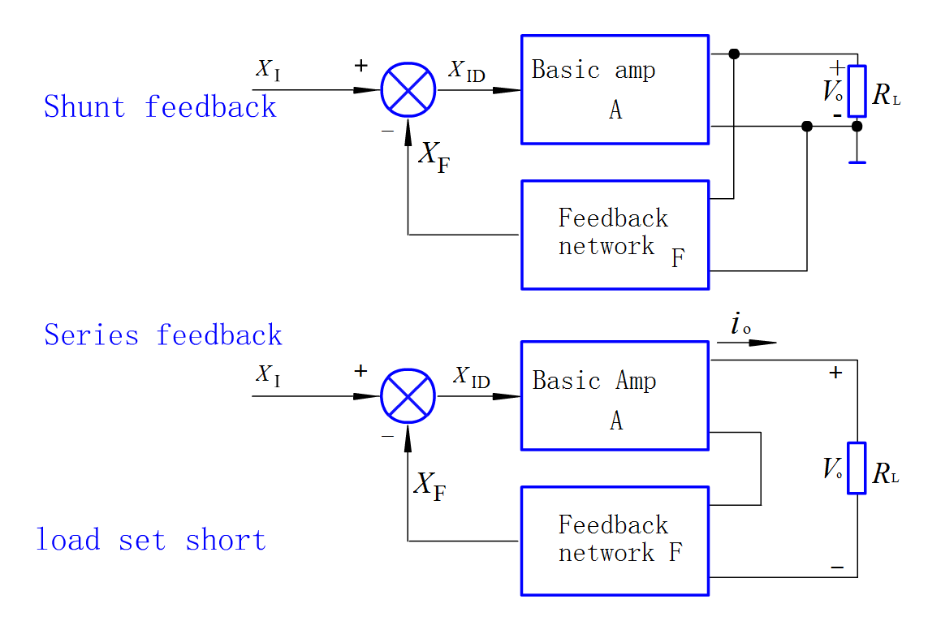

Slide 9
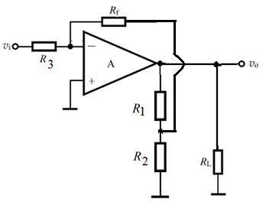
Shunt (voltage-sensing):
The output not
connect to GND
u_{o}
u_{o}
R_{L}
R_{L}
Feedback comes from the output without connecting to GND.
Sampling resistor
must be large
Shunt (voltage-sensing)

Slide 10
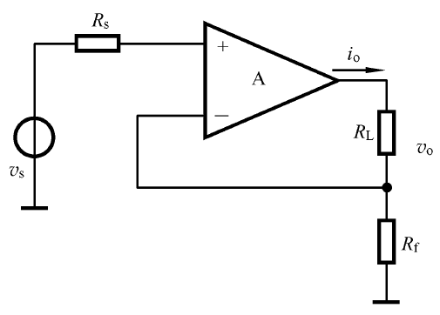

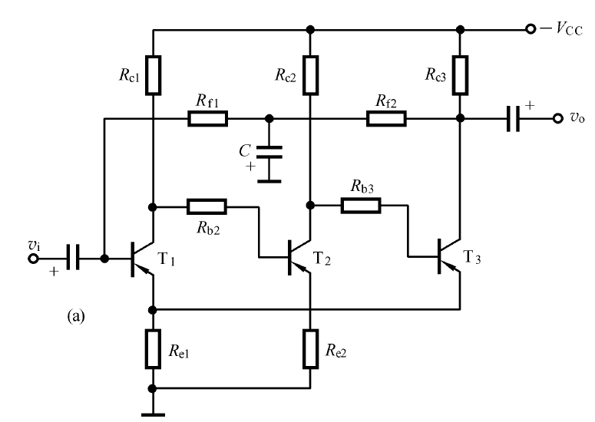
Series (current-sensing):
i_{o}
i_{o}
R_{L}
i_{E}
i_{E}
R_{f}
R_{L}
Sampling resistor
must be small
Feedback does not come from the output without connecting to GND.

Slide 11
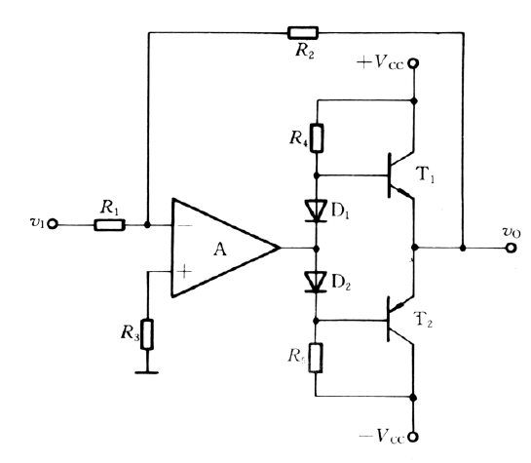
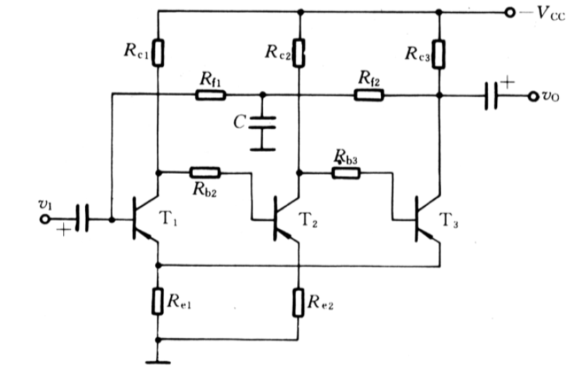
AC Feedback configuration
(-)
(+)
(+)
(-)
(-)
(+)
(-)
(-)
(+)
(+)
(+)
(+)
shunt
shunt
series
series

Slide 12
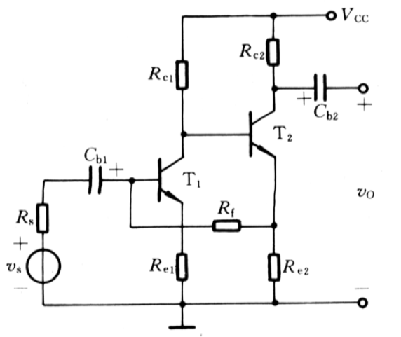
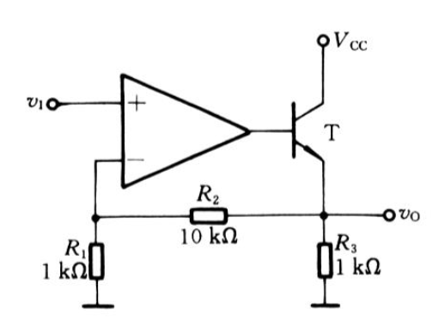
AC Feedback configuration
(+)
(+)
(-)
(-)
(+)
(+)
(+)
(+)
(-)
series
(-)
shunt
shunt
series

Slide 13
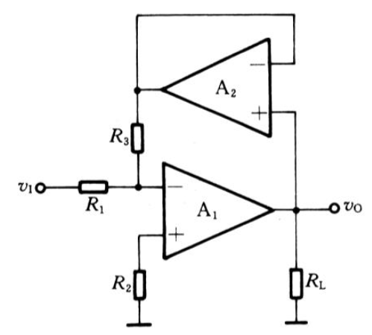
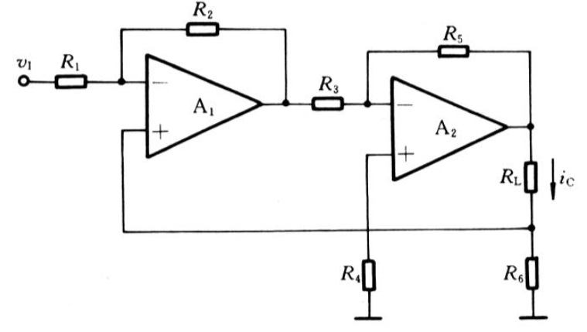
AC Feedback configuration
(-)
(-)
(-)
(+)
(+)
(+)
(-)
(-)
(+)
(+)
(-)
(+)
series
(+)
shunt
shunt
series

Slide 14
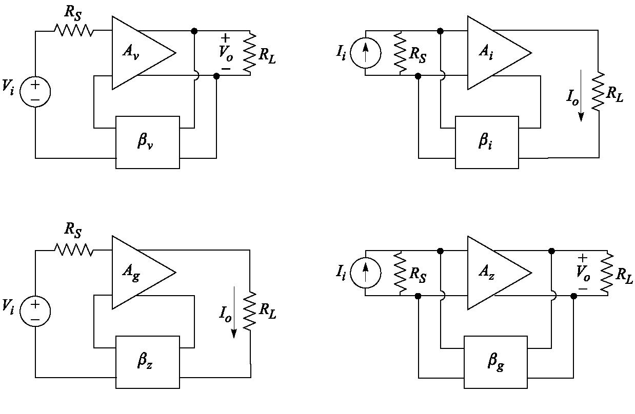




Four connections

Slide 15

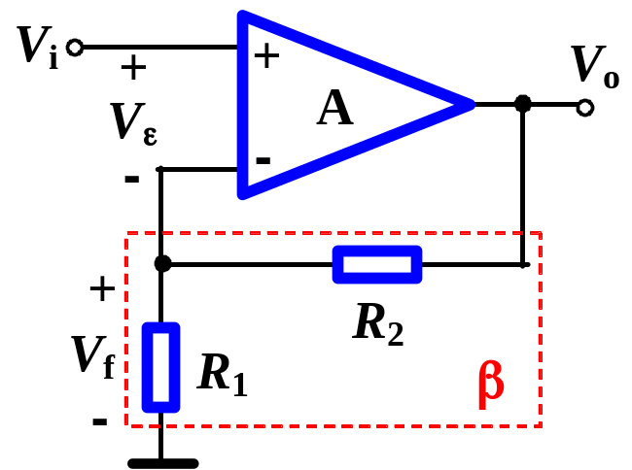
Pay attention to
(1) Series-shunt configuration
(+)
(+)
since
V_{ε} = V_{i} -V_{f}
v_{ε} ↑
(+)
V_{o}↓
V_{f}↓
V_{ε} ↑
V_{o}↑
Series-shunt
Series on input：concerning voltage signals（KVL）
Shunt on output：output voltage tends to be stabilized

Slide 16
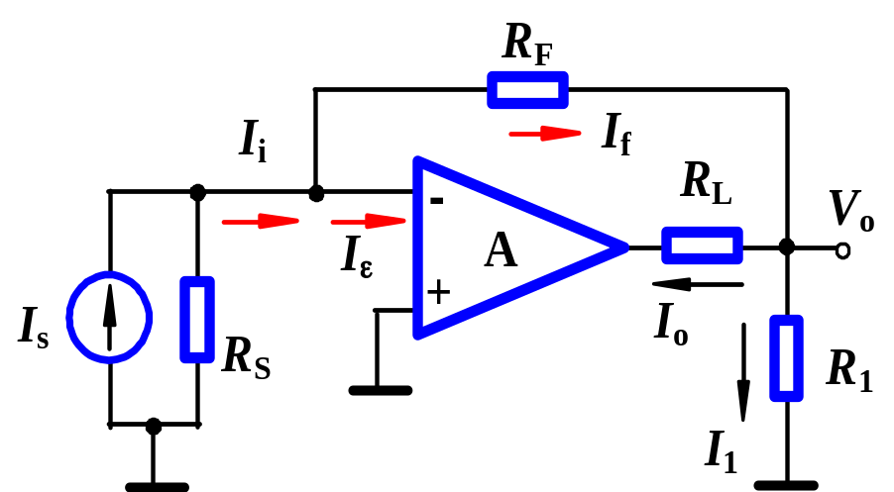
Pay attention to
(2) Shunt-series configuration
(+)
(+)
(−)
since
i_{ε} = i_{i} -i_{f}
R_{L} ↑
i_{o}↓
i_{f}↓
i_{ε} ↑
i_{o}↑
Shunt-series
Shunt on input：concerning current signals（KCL）
Series on output：output current tends to be stabilized
We have same conclusions for other two configurations

Slide 17
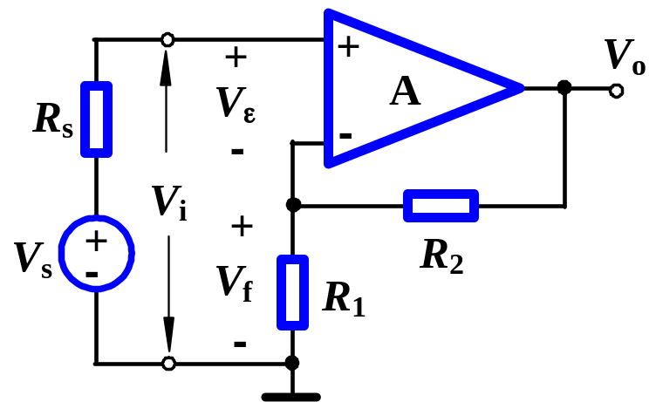
Pay attention to
(+)
(+)
Series on input
(+)
V_{ε}= V_{i} -V_{f}
If changing of V_{f} causes changing of V_{ε} efficiently.
Series-shunt
Input signal source should be voltage source, and small source resistance is desirable.

Slide 18
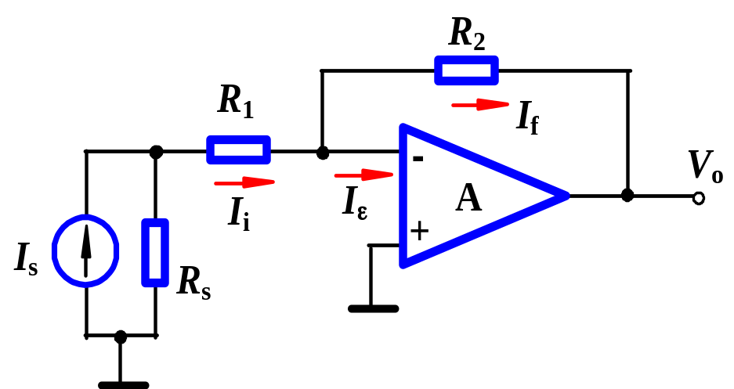
Pay attention to
Shunt on input
(+)
(+)
(−)
I_{ε} = I_{i} -I_{f}
Shunt-shunt
If changing of I_{f} causes changing of I_{ε} efficiently.
Input signal source should be current source, and large source resistance is desirable.

Slide 19
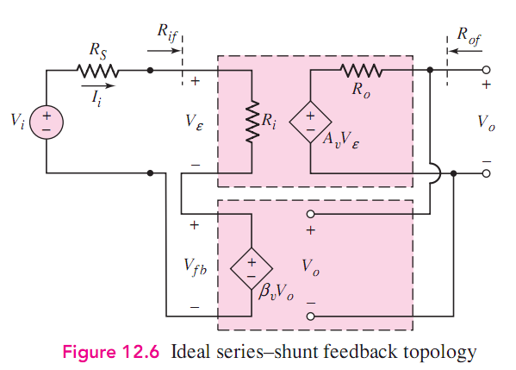


Voltage－Voltage Amplifier

Slide 20






Slide 21



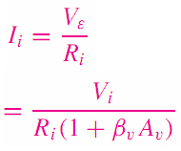


A Series input connection increases input resistance by a factor of (1+Aβ).

Slide 22

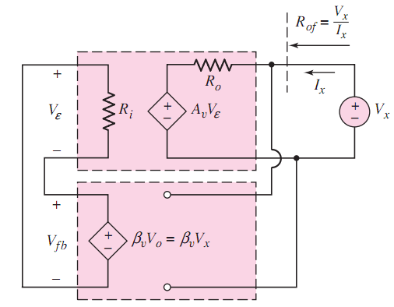







A shunt output connection decreases output resistance by a factor of (1+Aβ).

Slide 23
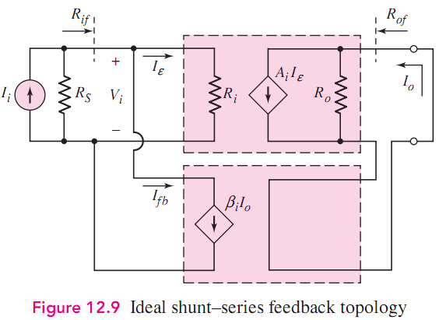

current－current Amplifier

Slide 24





Slide 25






A shunt input connection decreases input resistance by a factor of (1+Aβ).

Slide 26
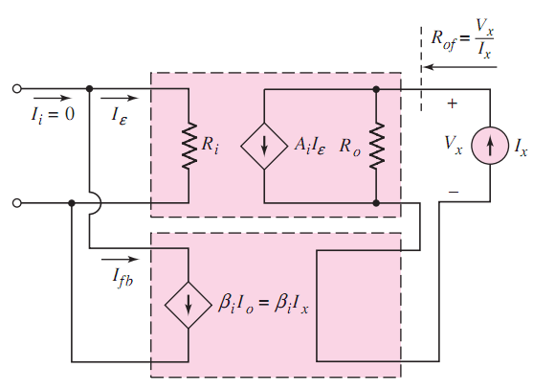





A series output connection increases output resistance by a factor of (1+Aβ).

Slide 27
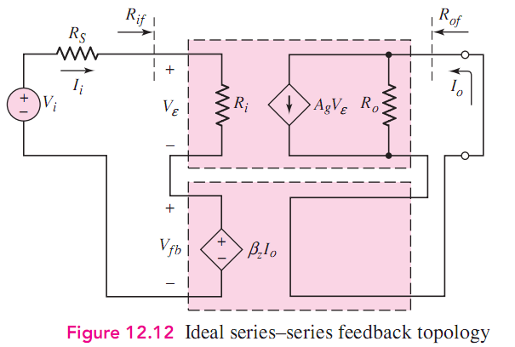

Voltage－current Amplifier

Slide 28



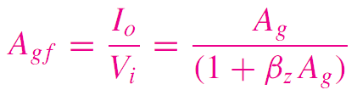


Slide 29
Determine the effects of the feedback on the input resistance and
the output resistance？

Slide 30
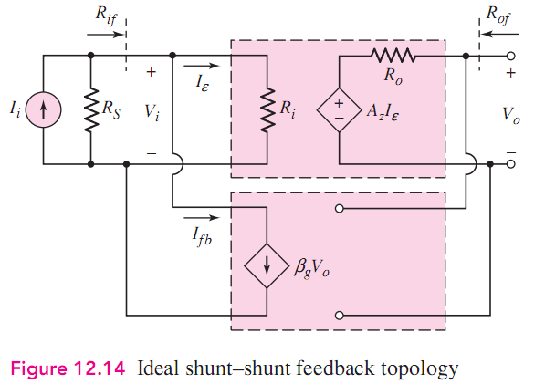

Current － Voltage Amplifier

Slide 31



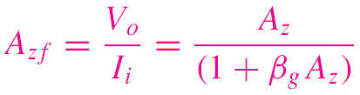


Slide 32
Determine the effects of the feedback on the input resistance and
the output resistance？

Slide 33
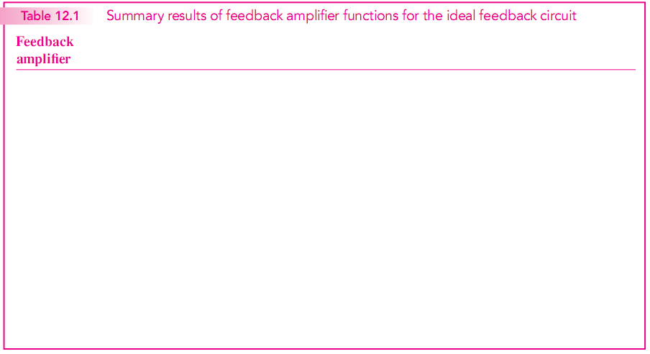













increases
decreases
decreases
increases
increases
increases
decreases
decreases

Slide 34
Questions
and
Answers

